Slide 1
26 January 2022
Aircraft Design Capstone Course
Presentation to ASE 374 – COE Senior Design Course
Greg Zwernemann
Professor of Practice, The University of Texas at Austin

Slide 2
Design Capstone Project
Use Case Scenario
There has been flooding around Austin
Austin Fire Department (AFD) receives reports of water rising above level of homes
AFD directs Contractor UAS to search for people in need of assistance on roof tops of homes surrounded by water
AFD performs rescue using data provided by UAS
Course Outcomes Defined by “Contract” Requirements
RFP issued to students
Students form competitive teams
Teams submit “proposal”
Contracts “awarded”

Slide 3
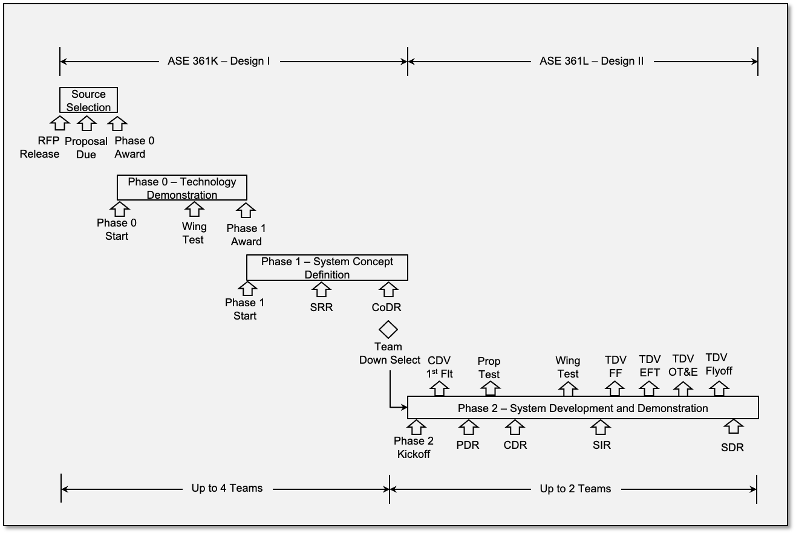
Aircraft Design Program Plan

Slide 4
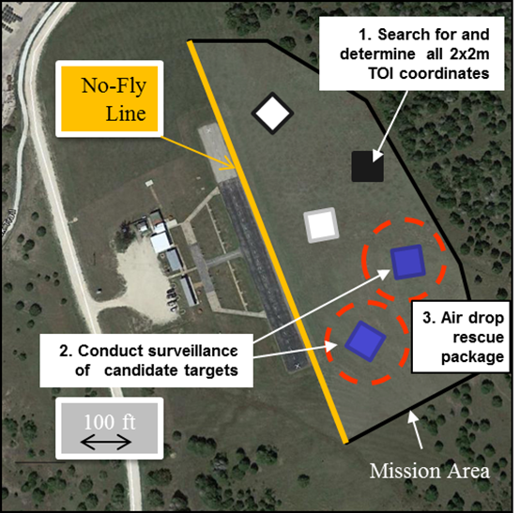
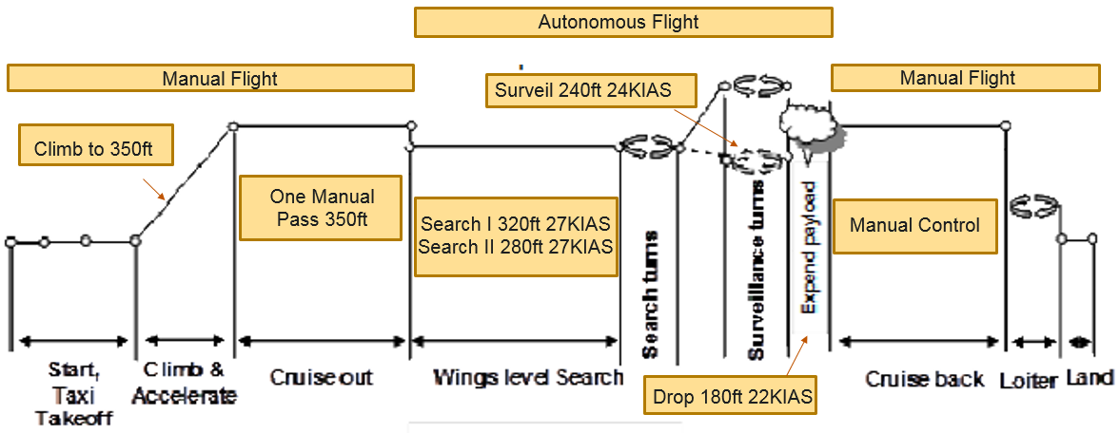
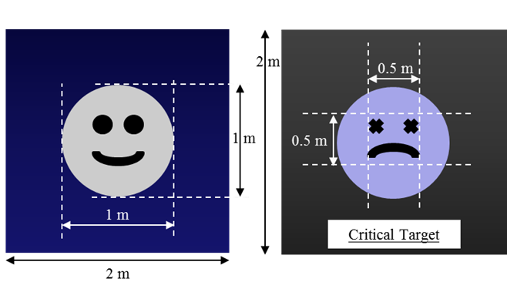
Design II Competitive Flyoff
Demonstration Objectives
Rapid deployment to Area of Interest (AOI)
Perform search to locate Targets of Interest (TOI)
Perform continuous circular surveillance of candidate critical TOI
Deliver first aid rescue package to critical TOI
Return to Base
Deliver map defining TOI locations, photos and telemetry to AFD
Mission time objective < 40 minutes
Scored mission Measures of Effectiveness (MoEs)
Mission Demonstration Area
Candidate Critical Targets of Interest (TOI)

Slide 5
System Architecture

Slide 6
Aircraft Development Process
Air Vehicle Kit (RTF)
Point of Departure (POD)
Technology Demonstrator Vehicle (TDV)
Team Crown and Airframe

Slide 7
Aircraft Subsystems Description
Team Crown and Airframe

Slide 8
Aircraft Subsystems Description
Team Crown and Airframe

Slide 9
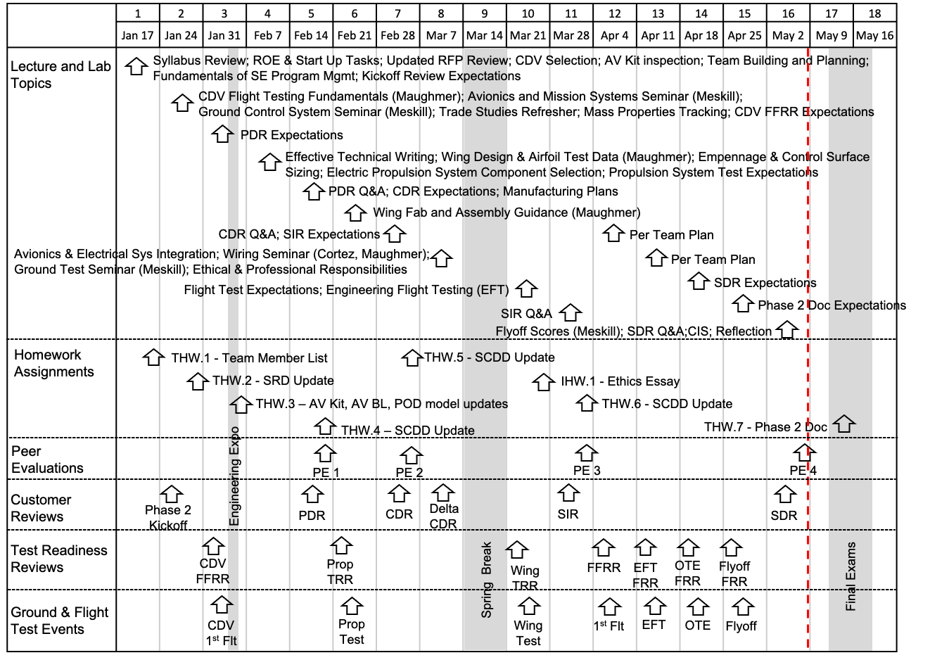
Aircraft Design II – Spring 2022 Schedule

Slide 10
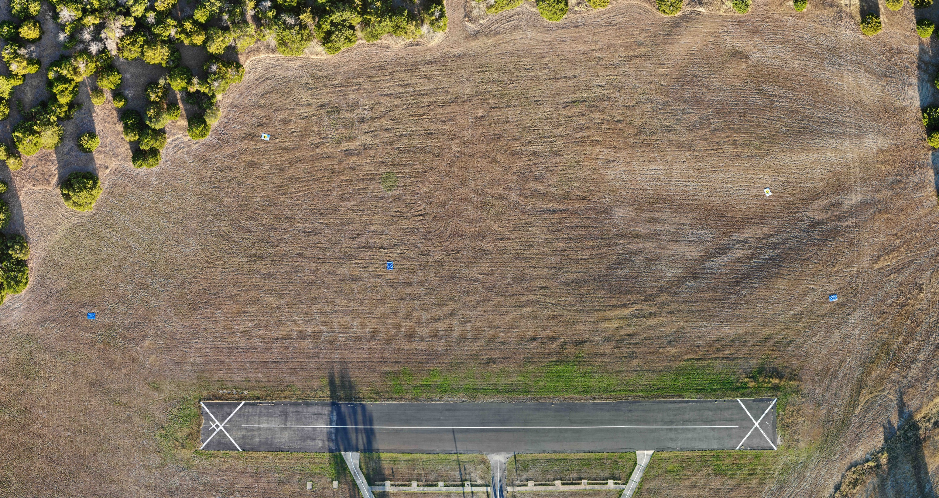
Austin Radio Control Association Search Area

Slide 11
Precision Guided Air Dropped Payloads
One of the key objectives of the Aircraft Design mission is to drop a first aid kit to people stranded on a rooftop with flood waters surrounding the home. The target is a 1600 sq ft home,
approximately 40’x40’.
Currently the Aircraft Design teams drop an unguided package with a streamer (providing drag) usually using manual timing. Some teams have pre-calculated ballistic trajectories with altitude, aircraft speed, and cross-winds as parameters. However, none have used payload guidance or automatic launch capabilities enabled by the autopilot (Pixhawk).
The objective of the COE Design Project could be to incorporate automatic payload drops that exploit
autopilot capabilities and/or payload package guidance using control surfaces or other methods.
The Aircraft Design RFP provides all of the necessary mission requirements, payload package
geometric and weight requirements, and a set of TPMs that measure miss distance for scoring.
The Aircraft Design students could fly the mission with unguided and manually launched payloads
and then do another flight using the COE developed payload delivery solution. You will need
to collaborate on interfaces with the autopilot and payload release mechanism.

Slide 12
Automatic Target Recognition and Map Generation
One of the key parts of the Aircraft Design mission is to find potential targets (people stranded on rooftops) and categorize each as a critical target (which need a payload drop) or a non-critical target (which will be provided in a map delivered to AFD). Currently, the Aircraft Design students conduct a search to identify potential targets and then perform surveillance passes to categorize them as critical (frowny face) or non-critical (smiley face) by using Mark I human eye balls to categorize the targets. The time spent to perform this part of the mission is a key driver for the overall mission success TPMs.
The objective of the COE Design Project would be to automate the search and surveillance segments of the mission to minimize the total time requirement. This could involve use of automatic target recognition (ATR) and generation of waypoint guidance to minimize search and surveillance time. The Pixhawk autopilot has a capability to accept inputs from an aircraft mounted co-processor, which could perform the ATR. Waypoints could be generated by the co-processor also, or transmitted from another ground control station computer running a COE developed algorithm. The Aircraft Design team could use manual methods for one flight test and then another would be performed using theCOE developed system.
Another key mission product is a map to be delivered to AFD that identifies the critical and non-critical targets. AFD then sends rescue personnel to these locations. Current Aircraft Design teams usually process this information manually after the aircraft returns to base. The time to perform the map generation is also part of the competition and there are defined TPMs.
The objective would be to develop an automated map generation capability that minimizes the time required to get the map delivered to AFD. Several techniques could be developed to improve the target location accuracy, e.g., use of Euler angles (derived from GPS and autopilot attitude data) vs overflight with bore-sighted camera. This project could also exploit an aircraft mounted co-processor. The ultimate objective might be to deliver the completed map immediately upon landing by downloading from the co-processor to a thumb drive or possibly before landing by using the telemetry or video datalink. The flight demonstration missions could be flown with and without the COE map generation solution.

Slide 13
Points of Contact
TA: David Meskill
meskillschool@gmail.com
Assuming Incompressible
Program Manager: Riley Jacobs - rileymjacobs@utexas.edu
Lift and Drag Queens
Program Manager: Grace Kirk - grace.kirk@utexas.edu

Slide 14
Greg Zwernemann, Professor of Practice
512-645-5922
greg.zwernemann@austin.utexas.edu
www.engr.utexas.edu
THANK YOU.

